Slide 1
KG using KDD Data
The test set data of 2005-06 was used to try if we can implement a KG using this data. After some preprocessing I got the exact concept name and the section name in different columns of the data, and then as per the required input in the KG code, these columns were given out in a txt file in the order including the skills, relations, relatives and keys, so that it can be feed to the KG code to implement KD.
Link to KDD code, KG code, KG image is https://github.com/Team-MateRate/MateRate-ML-AI/blob/master/Group2/Week%205/test_data_kg.ipynb

Slide 2
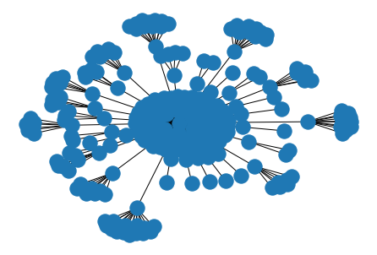
KG using KDD data
This KG limits the KG traversal part, as there are unique paths for travelling from one node to another for almost all cases.

